Slide 1

Geography of the US Opioid Crisis: space-time patterns of mortality using R
November 30, 2017
Data Science for Biomedical Informatics (BMIN503/EPID600)
David N Karp, MUSA
Department of Biostatistics, Epidemiology & Informatics
Perelman School of Medicine, University of Pennsylvania, Philadelphia, PA USA
Notes:
Talk today is called, geography of acute care, developing a population-based unit of analysis for emergency care
Want to talk about work we have been developing with our group in Philadelphia
As the title suggests, we are using geographic approach to develop a new unit of analysis, that can be used to measure population health, specifically for emergency care, and that can someday soon be used to incentivize coordination between healthcare provides regionally

Slide 2
Introduction
Objective
To analyze space-time patterns of drug overdose mortality in the US, in order to identify key drivers of regional variability.
Notes:
– Dartmouth Atlas of Health Care cornerstone of understanding regional variability
– will you have access to care where and when you need it?
-- trauma, stroke, stemi are currently coordinated regionally (regionally protocols, tiered care system), calls to do so for cardiac arrest, as well

Slide 3
Introduction
Background
Drug-related deaths have reached a all time-year high (65,000 people in 2016, 400% increase 1999, surpassing peak gun, HIV, car crash deaths)
Account for 30% of accidental deaths in the country
Estimated cost of $50-80B (healthcare, criminal justice, socioeconomic burden)
Opioids are a class of drugs that include heroin as well prescription pain relievers (oxycodone, hydrocodone, codeine, morphine, fentanyl)
Origins of the crisis have include roles of:
pain management and palliative care,
law enforcement and ‘Drug War’ policies/policing,
treatment for mental health and addiction/substance abuse,
decriminalization/legalization of medical/recreation marijuana,
job loss and economic downturns,
among many other social, economic, political factors
Federal gov’t slow to declare a PH emergency (Oct 2017)
Funding allocated (2017, HHS invested $900 million in opioid-specific funding)
support treatment and recovery services, target availability of overdose-reversing drugs, train first responders [www.samhsa.gov]
Changing role of race and class, though mainstream rhetoric/response remains the same
Notes:
– Dartmouth Atlas of Health Care cornerstone of understanding regional variability
– will you have access to care where and when you need it?
-- trauma, stroke, stemi are currently coordinated regionally (regionally protocols, tiered care system), calls to do so for cardiac arrest, as well

Slide 4
Introduction
Aims
This study aims to:
Analyze sub-regional variability in mortality rates
Identify spatial and temporal patterns through a hot-spot/cluster analysis
Estimate/predict outcomes based on multiple factors (demographic, healthcare, public health, socio-economic, political, built environment)
Compare principle factors among high and low rate clusters and outliers
Learn R (data management, statistical analysis, spatial analysis/GIS)
Notes:
– Dartmouth Atlas of Health Care cornerstone of understanding regional variability
– will you have access to care where and when you need it?
-- trauma, stroke, stemi are currently coordinated regionally (regionally protocols, tiered care system), calls to do so for cardiac arrest, as well

Slide 5
Methods
Study Population/Data
Cross-sectional data for all deaths in the US (not including outlying territories)
Five 1-year time periods (1995, 2000, 2005, 2010, 2015)
Outcomes
Multiple Cause of Death (MCOD) files Centers for Disease Control and Prevention (CDC/NCHS/NVSS)
Limited dataset, incident level observations, state/county-level geographic identifiers (location of death)
Detailed age, sex, and race/ethnicity
Up to 20 recorded cause of death codes (International Classification of Diseases, Ninth (ICD-9) and Tenth Revisions (ICD-10)
Drug-related deaths, accidental, prescription drugs, opioids, heroin
Explanatory Factors
Multiple sources

Slide 6
INDICATOR | VARIABLE NAME | GEOGRAPHIC SCALE/SCOPE | TIME SCALE/SCOPE | SOURCE
OUTCOMES | all deaths | County, National | Annual, 1995-2015 | MCOD
 | drug related deaths | County, National | Annual, 1995-2015 | MCOD
 | accidental drug deaths | County, National | Annual, 1995-2015 | MCOD
 | prescription drugs deaths | County, National | Annual, 1995-2015 | MCOD
 | opioid analgesic deaths | County, National | Annual, 1995-2015 | MCOD
 | heroin deaths | County, National | Annual, 1995-2015 | MCOD
DEMOGRAPHICS | race | County, National | Annual (5-year est) | ACS
 | sex | County, National | Annual (5-year est) | ACS
 | age | County, National | Annual (5-year est) | ACS
 | ethnicity | County, National | Annual (5-year est) | ACS
 | household status | County, National | Annual (5-year est) | ACS
SOCIAL | education | County, National | Annual (5-year est) | ACS
 | household income | County, National | Annual (5-year est) | ACS
 | inequality
 | mobility
 | homelessness
BUILT ENVIRONMENT | urban/rural | County, National |  | USDA/ERS
 | population density | County, National | Annual (5-year est) | ACS
 | vacancy
SOCIOPOLITICAL | voted democratic/republican in presidental election
ECONOMIC | population change | County, National | Annual (5-year est) | ACS
 | unemployment | County, National | Annual (5-year est) | ACS
 | job growth/loss
 | building permits |  |  | Census
 | gross domestic product | State/Metro, National |  | BEA
 | employment by industry sector |  |  | BEA
 | wages
 | housing market
CRIME | violent
 | narcotics
HEALTHCARE | utilization (ED visits/inpatient days) | County, National | Annual | AHRF
 | access
 | quality
 | providers | County, National |  | AHRF
 | opioid prescription rates
 | pain clinics |  |  | NAICS

Slide 7
INDICATOR | VARIABLE NAME | GEOGRAPHIC SCALE/SCOPE | TIME SCALE/SCOPE | SOURCE
HEALTHCARE | utilization (ED visits/inpatient days) | County, National | Annual | AHRF
 | access
 | quality
 | providers | County, National |  | AHRF
 | opioid prescription rates
 | pain clinics |  |  | NAICS
 | trauma centers
 | teaching hospitals | County, National | Annual, 2010-2014 | AHA
 | emergency departments | County, National | Annual, 2010-2014 | AHA
 | Herfindahl-Hirschman index (HHI)
TREATMENT/SOCIAL ASSISTANCE | methadone clinics
 | emergency relief
PREVENTATION/ HARM REDUCTION | availability of Narcan
 | needle exchanges
POLICY | incarceration rates
 | legalization of marijuana (medical, recreational, decriminalization)
PUBLIC HEALTH | funding for research
 | awareness campaigns
HEALTH STATUS | substance abuse
 | nutrition
 | primary care
 | mental health
 | STDs
 | suicide rates | County, National | Annual, 1995-2015 | MCOD
INSURANCE | coverage status | County, National | Annual (5-year est) | ACS
 | medicaid expansion
PHARMACEUTICAL | payments to doctors
GEOGRAPHY | state | NA | Annual, 1995-2015 | TIGER
 | region | NA | Annual, 1995-2015 | TIGER
 | coastal | NA | Annual, 1995-2015 | TIGER
 | international border | NA | Annual, 1995-2015 | TIGER

Slide 8
Methods
Analysis
Part I – Descriptive Analysis
- Descriptive statistics, univariate tests
Part II – Spatial Analysis (outcomes)
- Hotspot mapping, global/local spatial autocorrelation, cluster classification
Part III – Regression Analysis
- Linear and logistic regression modeling, multivariable
Part IV – Machine Learning (classification and prediction)
- K-means (unsupervised), Random forest model (supervised), cross-validation
Part V – Visualization (explanatory factors)
- Heat mapping, clustering

Slide 9
Results
Preliminary findings
Individual-level analysis [unadjusted]
Plot all overdose by age, sex, race + year
5X increase between 2000 and 2015 (all overdoses)
Almost 6X increase in heroin deaths
Highest total deaths among 35-54 y/o in all years
Almost 20X increase in 55-84 y/o (raw count + proportion of all deaths)
1.6X increase in proportion of female deaths
Decrease in the share of Black and Hispanic deaths
Majority of deaths occur outside the hospital system
Non-heroin deaths are whiter, and older, and occur outside of the health system
State/county-level analysis
3-fold variability in state and county level rates
Clustering among US states, Global Moran’s=0.32, p<0.01
Hotspots among counties (n=87) in NE/Appalachia, Local I -0.01-.42 (IQR)

Slide 10
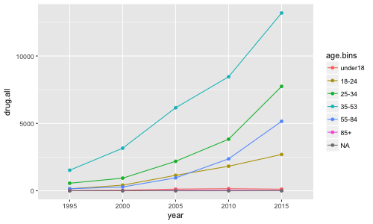
All Drug Deaths by Age (1995-2015)

Slide 11
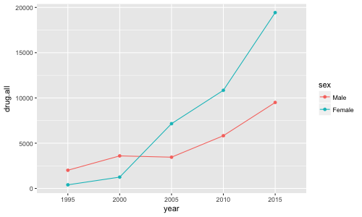
All Drug Deaths by Sex (1995-2015)

Slide 12
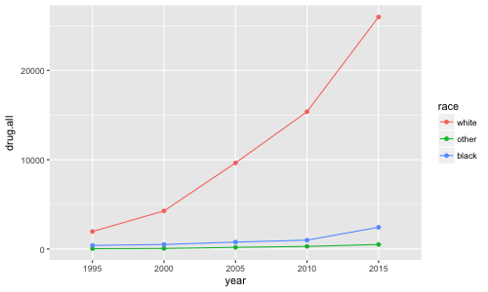
All Drug Deaths by Race (1995-2015)

Slide 13
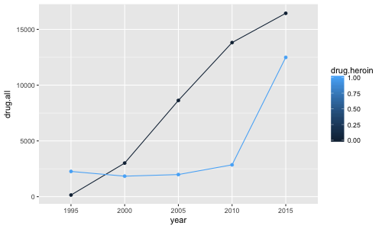
All Drug Deaths, Heroin v. Rx Opiates (1995-2015)

Slide 14
Summary of Opiates Only (Rx & Heroin), by year
 | 1995 | 2000 | 2005 | 2010 | 2015 | p test
n | 2410 | 4849 | 10610 | 16669 | 28930
heroin = 1 (%) | 2263 (93.9) | 1839 (37.9) | 1983 (18.7) | 2855 (17.1) | 12488 (43.2) | <0.001
sex = Female (%) | 400 (16.6) | 1252 (25.8) | 7156 (67.4) | 10844 (65.1) | 19432 (67.2) | <0.001
race (%) |  |  |  |  |  | <0.001
white | 1965 (81.5) | 4266 (88.0) | 9643 (90.9) | 15374 (92.2) | 25982 (89.8)
other | 41 ( 1.7) | 66 ( 1.4) | 188 ( 1.8) | 297 ( 1.8) | 511 ( 1.8)
black | 404 (16.8) | 517 (10.7) | 779 ( 7.3) | 998 ( 6.0) | 2437 ( 8.4)
hispanic = hispanic (%) | 517 (21.5) | 587 (12.1) | 870 ( 8.2) | 1157 ( 6.9) | 2574 ( 8.9) | <0.001
age (mean (sd)) | 39.52 (10.79) | 39.70 (10.60) | 40.21 (12.04) | 40.79 (12.76) | 41.02 (12.89) | <0.001
age.bins (%) |  |  |  |  |  | <0.001
under18 | 13 ( 0.5) | 40 ( 0.8) | 125 ( 1.2) | 156 ( 0.9) | 121 ( 0.4)
18-24 | 147 ( 6.1) | 418 ( 8.6) | 1147 (10.8) | 1822 (10.9) | 2695 ( 9.3)
25-34 | 561 (23.3) | 937 (19.3) | 2187 (20.6) | 3827 (23.0) | 7746 (26.8)
35-53 | 1526 (63.4) | 3159 (65.2) | 6161 (58.1) | 8460 (50.8) | 13191 (45.6)
55-84 | 151 ( 6.3) | 282 ( 5.8) | 959 ( 9.0) | 2368 (14.2) | 5154 (17.8)
85+ | 9 ( 0.4) | 8 ( 0.2) | 30 ( 0.3) | 35 ( 0.2) | 20 ( 0.1)
placeofdeath (%) |  |  |  |  |  | <0.001
hospital | 1133 (47.0) | 329 ( 6.8) | 565 ( 5.3) | 1011 ( 6.1) | 2106 ( 7.3)
emergency | 648 (26.9) | 1039 (21.4) | 2040 (19.2) | 2930 (17.6) | 4836 (16.7)
outside health system | 629 (26.1) | 3481 (71.8) | 8005 (75.4) | 12728 (76.4) | 21988 (76.0)

Slide 15
Summary of Opiates Only (Rx & Heroin), by drug
 | Rx Opiates | Heroin | p test
n | 42040 | 21428
year (%) |  |  | <0.001
1995 | 147 ( 0.3) | 2263 (10.6)
2000 | 3010 ( 7.2) | 1839 ( 8.6)
2005 | 8627 (20.5) | 1983 ( 9.3)
2010 | 13814 (32.9) | 2855 (13.3)
2015 | 16442 (39.1) | 12488 (58.3)
sex = Female (%) | 25072 (59.6) | 14012 (65.4) | <0.001
race (%) |  |  | <0.001
white | 38684 (92.0) | 18546 (86.6)
other | 734 ( 1.7) | 369 ( 1.7)
black | 2622 ( 6.2) | 2513 (11.7)
hispanic = hispanic (%) | 2691 ( 6.4) | 3014 (14.1) | <0.001
age.bins (%) |  |  | <0.001
under18 | 382 ( 0.9) | 73 ( 0.3)
18-24 | 3583 ( 8.5) | 2646 (12.4)
25-34 | 8874 (21.1) | 6384 (29.8)
35-53 | 22290 (53.0) | 10207 (47.6)
55-84 | 6807 (16.2) | 2107 ( 9.8)
85+ | 98 ( 0.2) | 4 ( 0.0)
placeofdeath (%) |  |  | <0.001
hospital | 2929 ( 7.0) | 2215 (10.3)
emergency | 7176 (17.1) | 4317 (20.1)
outside health system | 31935 (76.0) | 14896 (69.5)

Slide 16
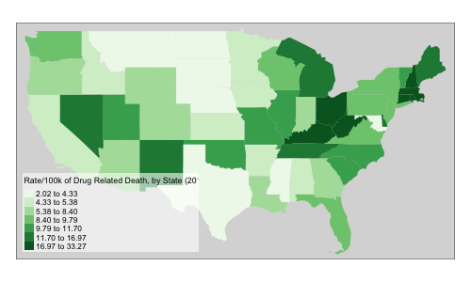
Drug-related Death Rate per 100,000 people, by state (2015)
Min. 1st Qu. Median Mean 3rd Qu. Max.
2.016 4.880 8.831 10.295 12.698 33.272

Slide 17
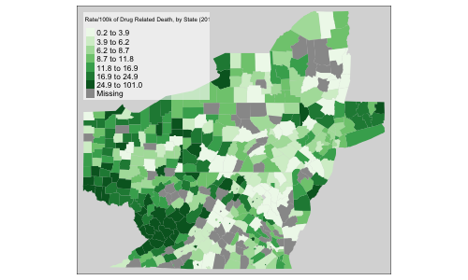
Drug-related Death Rate per 100,000 people, by county (2015)
Min. 1st Qu. Median Mean 3rd Qu. Max.
0.1953 6.1470 10.5572 13.9750 18.1747 100.9518

Slide 18
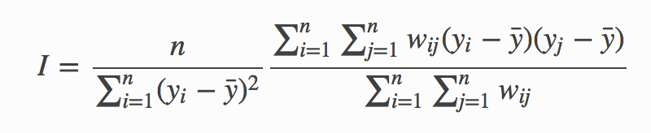
Spatial Autocorrelation
Nearer things are more closely associated
Null hypothesis is that values are spatially random
Global and local tests
positive = clustered, negative = dispersed
→ Summary correlation coefficient + spatial weight matrix

Slide 19
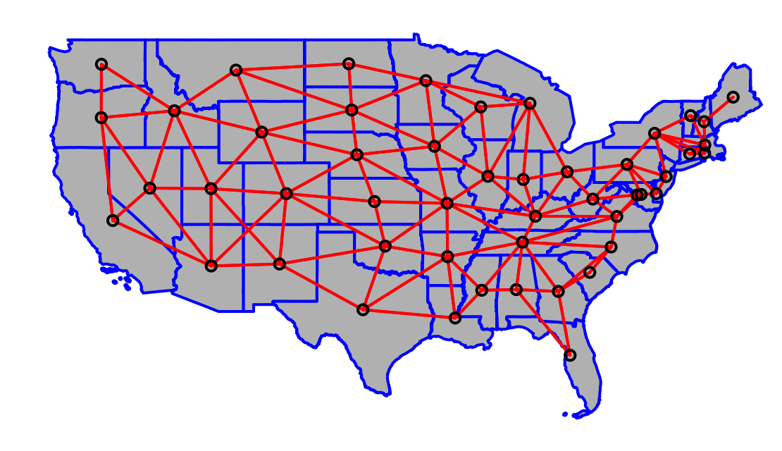
Nearest Neighbors Weight Matrix

Slide 20
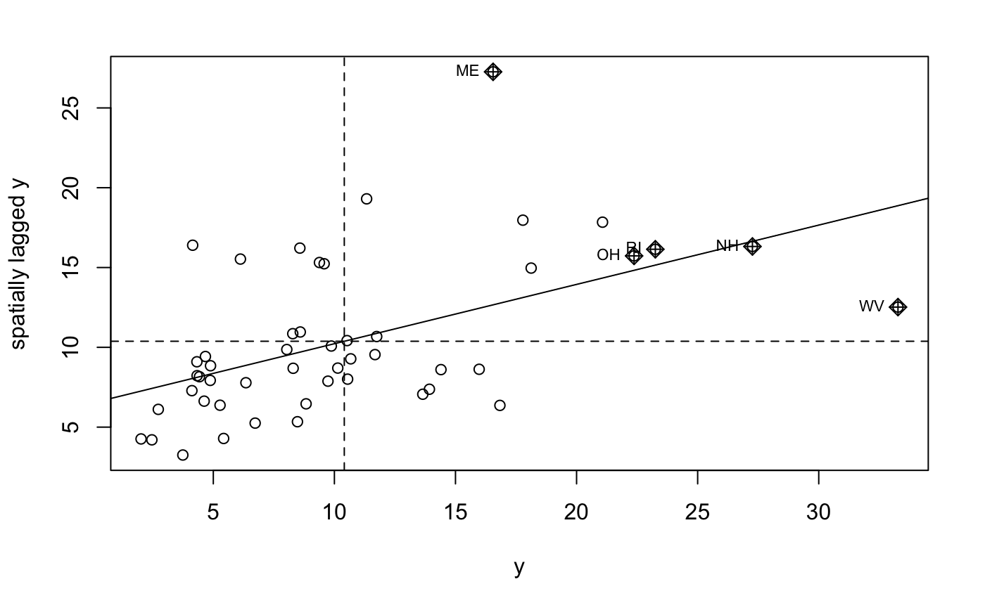
Global Moran’s I
statistic = 0.31597, observed rank = 100, p-value = 0.01

Slide 21
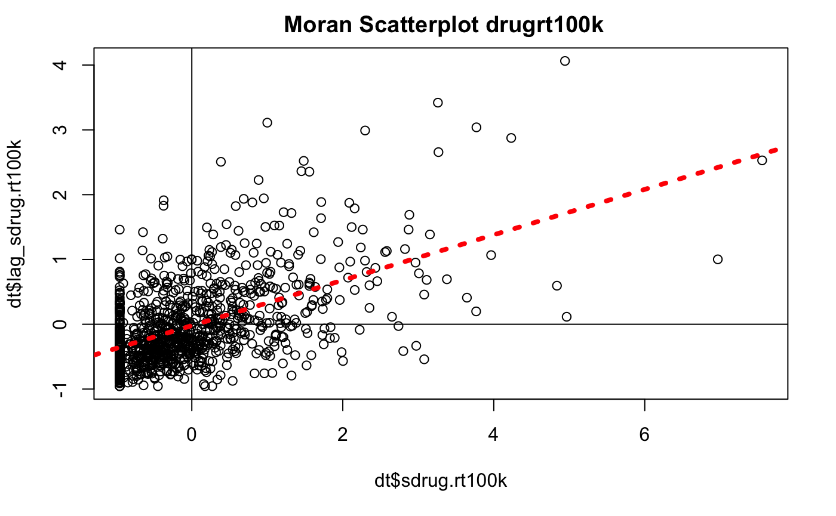
Local Moran’s I (county level)

Slide 22
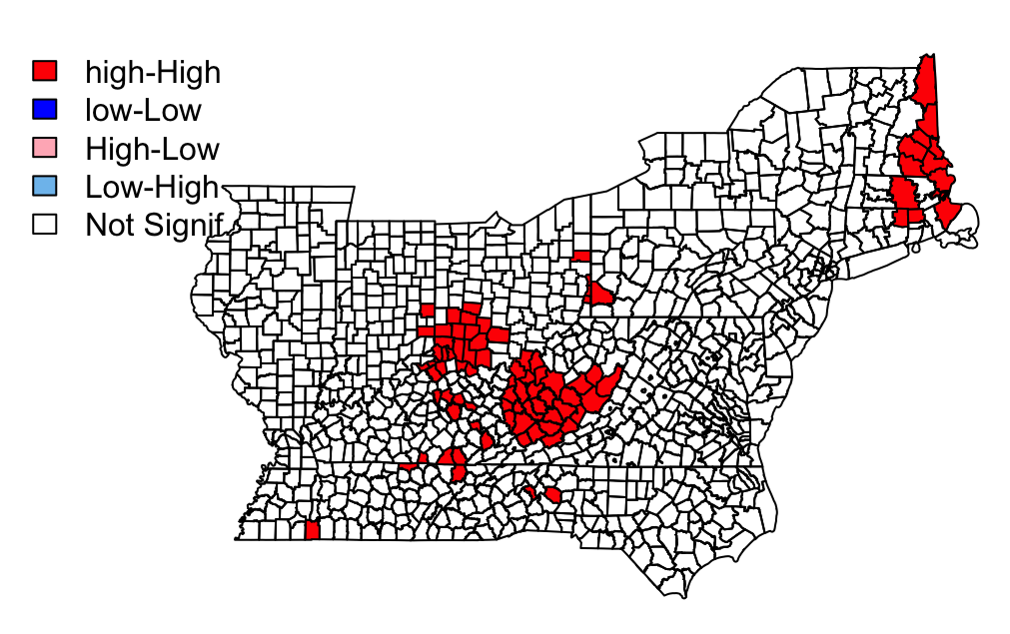
Classifying Clusters (+/- Local I, p<0.05)

Slide 23
Limitations & Next Steps
Challenges
Age-adjustment
Small counts
Missingness
Death certificate coding
Stability of pre-2000 data?
Future development
Pseudo-Bayesian models (space-time adjustments)
Geographically weighted/lagged regression
Spatially-enabled machine learning?

Slide 24
Discussion
Policy implications
How can research facilitate targeted/data-driven policy?
Reproducibility/data sharing
GitHub: https://github.com/dnkarp/BMIN503_Final_Project
RShinyApp: https://dnkarp.shinyapps.io

Slide 25
Acknowledgements & Notes
Co-authors/Advisors
Douglas J. Wiebe
Department of Biostatistics, Epidemiology, & Informatics
Chris Morrison
Penn Injury Science Center
M. Kit Delgado
Department of Emergency Medicine
R Packages & Other Resources
Spatial libraries: spdep, tmap
Python for web-scraping data

Slide 26
Thank you
David N. Karp
dkarp@pennmedicine.upenn.edu
https://github.com/dnkarp/BMIN503_Final_Project

